Slide 1
Automated Trading Solution for Multiple Stock Trading
Nandan Pandey- A20493184
Raj Shah- A20524266

Slide 2
PROBLEM STATEMENT: To design a reinforcement learning based financial model that helps in deciding trading strategies for multiple stock trading in order to obtain maximum portfolio value based on current and the current position (v_{t =} c_{t} + x₀p_{t}) using attributes such as open, close, high, low and other Technical indicators such as date, tic, operating margin, net profit margin, return over assets, return on equity, earnings per share, book per share etc. Here, v_{t} is total portfolio value, c_{t} is the current available cash and x₀p_{t} represents current position. Our aim is to maximize the total portfolio value v_{t} by selecting the efficient trading strategies.

Slide 3
Solution Overview: We model the stock trading process as a Markov Decision Process (MDP) which consist of: Action Space: Denoted as {−k, …, −1, 0, 1, …, k}, where k denotes the number of shares. For 30 stocks the entire action space is (2k+1)*30. State Space: Using 17 state space such as current ratio, quick ratio, cash ratio, inventory turnover, receivable turnover, payable turnover etc. (30 * 17 + 1). Reward Function: Derived by formula: Portfolio Value at stock’s close price - Portfolio Value at stock’s open price. Environment: multiple stock trading for Dow 30.

Slide 4

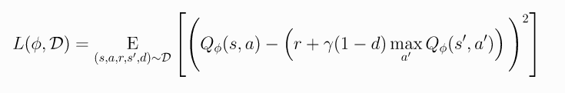
A2C:
TD_Error = TD_Target – V(s)
PPO:
DDPG:
We are using following Algorithms to train our models:

Slide 5
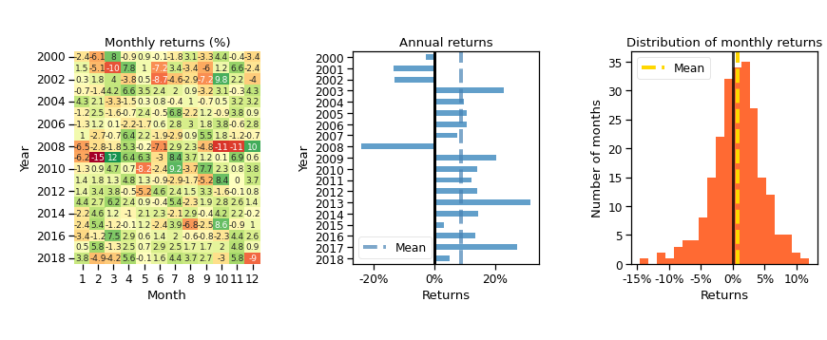
Backtesting Result:
We used pyfolio library to perform backtesting :
Monthly returns: Annual returns: Distribution of monthly returns:

